Slide 1
Remote Myoelectric Prosthetics
Soryan Kumar, Cat Nguyen, Daniel Chan

Slide 2
The Problem
Millions of Patients
Costly Solutions
Lack of Flexibility
20 million people live with permanent peripheral nerve injuries
Current prosthetics are expensive and unavailable to the general public
Scalability of current solutions prove impossible due to case-by-case treatments
Notes:
14% of COVID patients develop peripheral nerve injuries

Slide 3
Our Solution
A detector that uses a patient’s electrical signals between muscle fibers to remotely control a prosthetic device to substitute the patient’s damaged limb

Slide 4
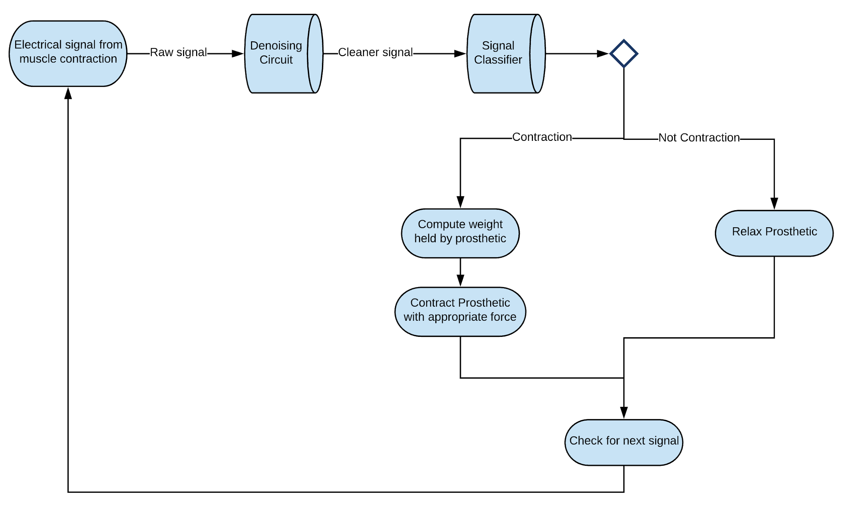
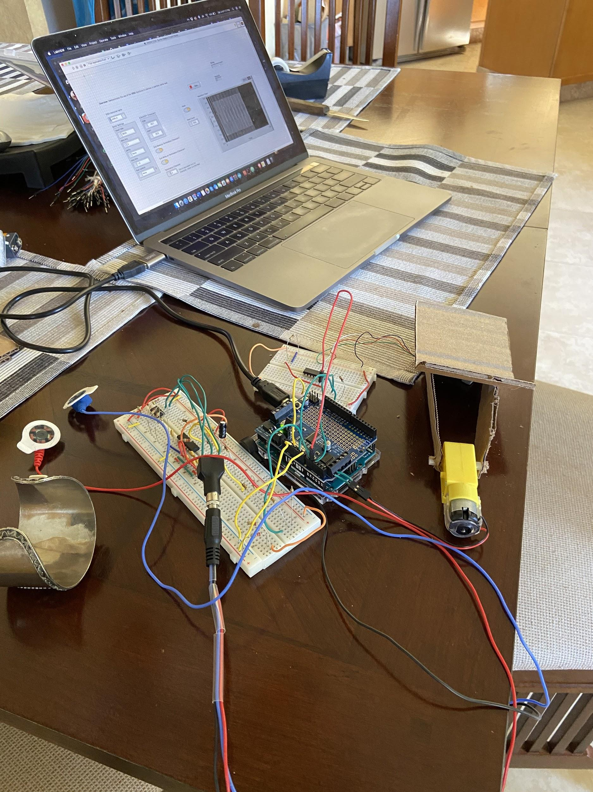
Details and Demo

Slide 5
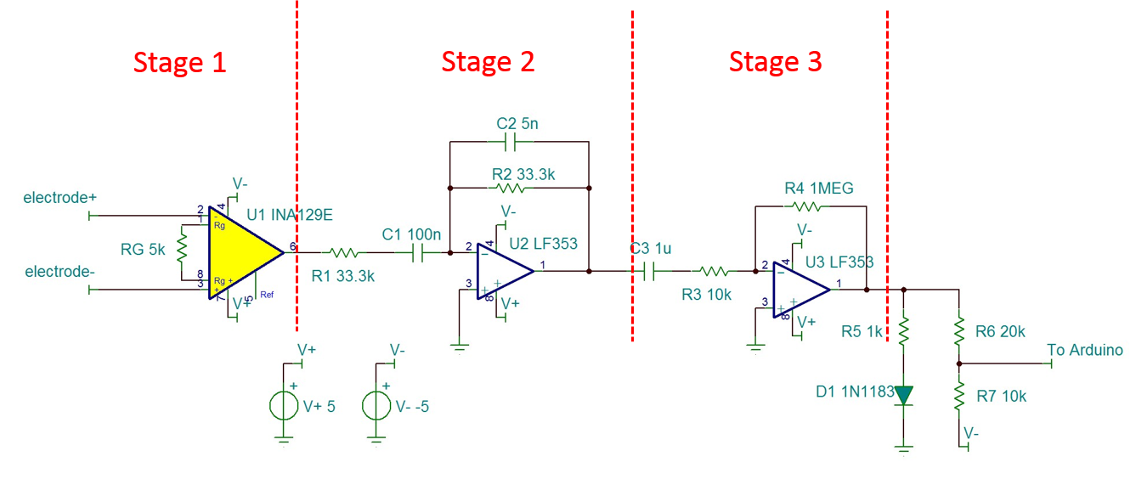
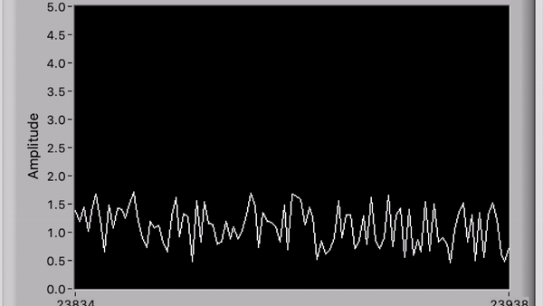

Slide 6
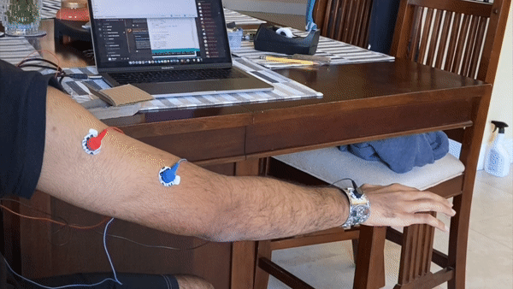
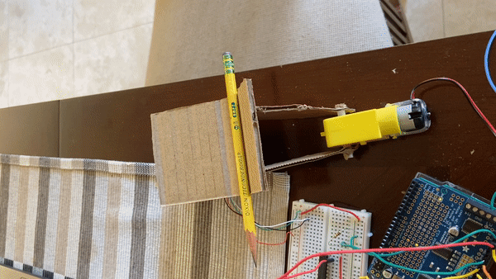

Slide 7
Advantages
Adaptable
Parameters can be easily tuned per patient
Cheap
Avoid excess costs like surgical modification
Scalable
Product can be mass produced for different market populations

Slide 8
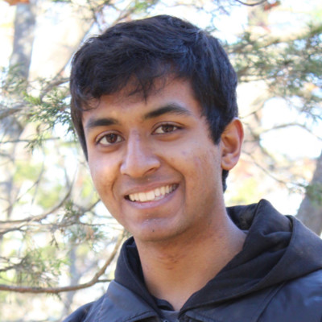
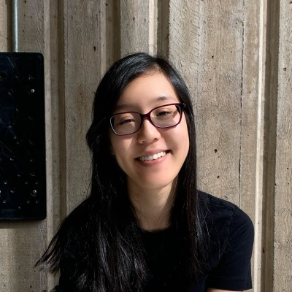
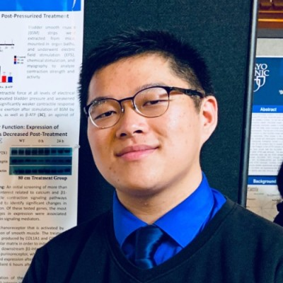
Our Team
Soryan Kumar
Cat Nguyen
Daniel Chan
Applied Math-Economics
Computer Science
Biochemistry
&
Public Health
Notes:
14% of COVID patients develop peripheral nerve injuries

Slide 9
Thank You!

